Slide 1
Supervised Learning Decision Trees and Random Forests
Daniele Marazzina
Politecnico di Milano

Slide 2
Example of a Decision Tree to Determine Criterion for Hiring

Slide 3
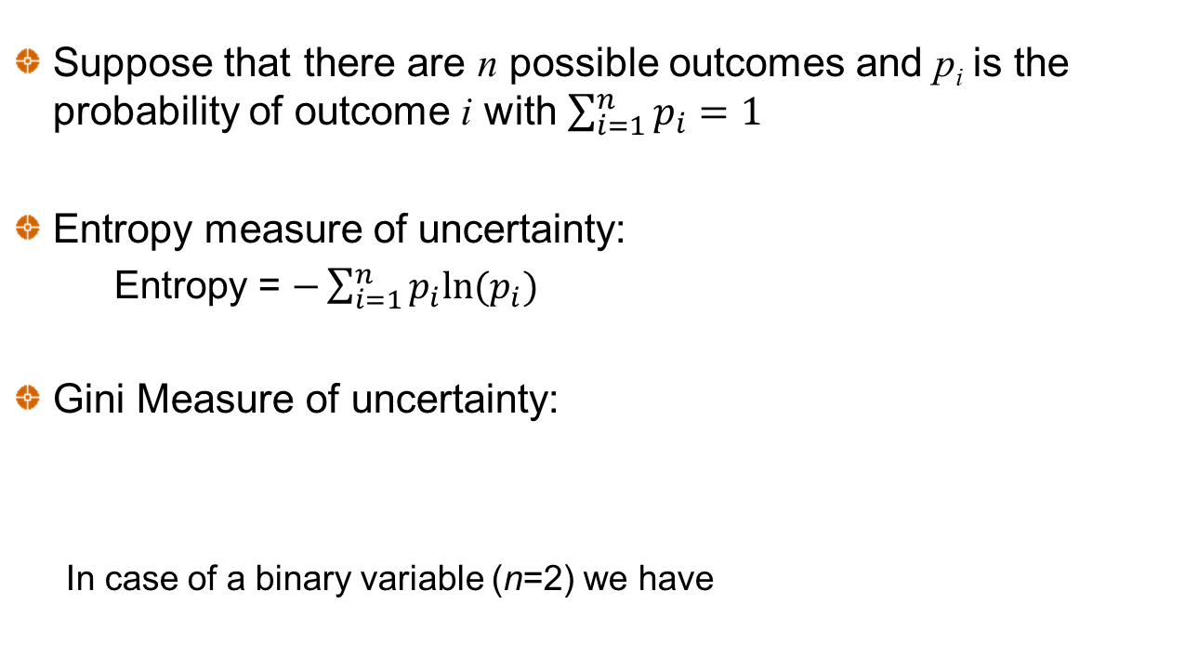
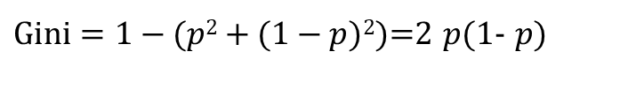
Measures of Uncertainty
Suppose that there are n possible outcomes and p_{i} is the probability of outcome i with $\sum_{i=1}^{n}{p_{i}=1}$
Entropy measure of uncertainty:
Entropy = $−\sum_{i=1}^{n}{p_{i}ln⁡(p_{i})}$
Gini Measure of uncertainty:
In case of a binary variable (n=2) we have
$\text{Gini}=1−(p2+(1−p$)²)=2 $p$(1- $p$)

Slide 4
Information Gain
The information gain is the expected decrease in uncertainty (as measured by either entropy or Gini).
Suppose that there is a 20% chance that a person will receive a job offer
Suppose further that there is a 50% chance the person has a relevant degree. If the person does have a relevant degree the probability of a job offer rises to 30%, otherwise it falls to 10%
Initial entropy = −[0.2log(0.2) + 0.8log(0.8)]=0.7219
(Note: log is log to the base 2 in ML)
Expected entropy =
−0.5[0.1log(0.1) + 0.9log(0.9)] − 0.5[0.3log(0.3) + 0.7log(0.7)]=0.6751
Expected information gain from knowing whether there is a relevant degree = 0.7219 − 0.6751=0.0468

Slide 5
The Decision Tree Algorithm
Algorithm chooses the feature at the root of the tree that has the greatest expected information gain
At subsequent nodes it chooses the feature (not already chosen) that has the greatest expected information gain
When there is a threshold, it determines the optimal threshold for each feature (i.e., the threshold that maximizes the expected information gain for that feature) and bases calculations on that threshold

Slide 6
Decision Tree
Classification Tree →the output variable is discrete and finite (usually binary)
Regression Tree → the output variable has continuous values

Slide 7
Classification Tree
Classification trees are recursive algorithms that split the dataset into smaller sets (nodes) in a step by step fashion thanks to binary rules defined on the features of the observations.
The complete dataset is the root node of the tree. To split the node, a feature is selected and a binary rule, e.g., if the value of the feature is larger or smaller than a given threshold, is defined on it in order to obtain two disjoint datasets. These two datasets become nodes of the tree. This procedure is repeated for each new node until a stopping criterion is met, e.g., the specified maximum depth of the tree is reached.

Slide 8
So a classification tree is a growing tree with nodes refining the information about the exogenous variables to classify an item in the database (in the binary case, class 0 or 1).
Each node is associated with a measure of Impurity. Such a measure is high when the dataset representing the node contains observations belonging to different classes of the endogenous variable, and reaches its lowest value (zero) when the node only contains observations belonging to a single class.
In the binary case, i.e. only two classes, we can use the Gini impurity. Given a node x, the Gini impurity, denoted by G(x), for a binary classier is defined as
G(x) = p(1 -p)
where p denotes the proportion of observations belonging to class 1, contained in node x. p can be interpreted as the probability of being of class 1 in the node. We can also use Entropy, instead of Gini index.

Slide 9
We aim to minimize the Gini index; its maximum (1/4) corresponds to the case in which a node is perfectly balanced (50% of the observations in the node are of class 0 and 50% of class 1, and therefore p = 1/2).
The feature (exogenous variable) and the binary rule that are used for the split at a node are defined through a search process that maximizes the impurity decrease after the split. Given a split rule r that divides node x (observations of the dataset) into the nodes xL and xR, we define the impurity decrease after the split as
G(x) – pL*G(xL) – pR*G(xR)
where pL (pR) is the percentage of observations in x that after the split belong to node xL (xR). The last nodes of the tree (the arrival point of the algorithm, i.e., the nodes that are not split anymore) are called leaves.
The leaves contain the estimation of the tree (in our case class 0 or 1), which is given by the most recurrent class in that leaf: if more than 50% of the observations in the leaf are of class 1, then the leaf is a class 1 leaf.
We also get a probability of being of class 1 for each leaf, given by the proportion of observations of class 1 in that leaf.

Slide 10
Lending - Classification Tree Choosing the root node – exploiting entropy
Initial entropy = −0.8276×log(0.8276)−0.1724×log(0.1724)=0.6632
Feature | Threshold value | Expected entropy | Expected Information gain
Home Ownership | N.A. | 0.6611 | 0.0020
Income | $85,202 | 0.6573 | 0.0058
Debt to income ratio | 19.87 | 0.6601 | 0.0030
FICO credit score | 717.5 | 0.6543 | 0.0088

Slide 11
Choosing the next node if FICO>717.5

Slide 12
The Tree
File: lending.ipynb © J.Hull

Slide 13
Choosing a criterion for accepting loans
As with logistic regression we can choose to accept loans where the probability of a good loan is above some threshold, Z

Slide 14

Regression Tree
Regression trees have basically the same structure as classification trees, but the dependent variable is a continuous variable, and the measure of impurity is the MSE of the observations in the node.
The quantity predicted by each leaf is the average of the values of the target variable of the observations in the leaf.
The MSE that measures the pureness of the node, computing the distance between the estimated value of the node (the average of the value of all the observations belonging to the node) and the value of the observations contained in the node, i.e., if there are N observations belonging to a node, and p_{i} is the value of observation i, i = 1,…,N, then we compute

Slide 15
House Price – Regression Tree
We construct a tree where instead of maximizing expected information gain we maximize the expected decrease in mean squared error
For root node we obtain
Feature | Threshold, Q | No. Obs ≤Q | mse of Obs ≤Q | No. obs > Q | mse obs >Q | Exp mse
Overall Quality | 7.5 | 1,512 | 2,376 | 288 | 7,312 | 3,166
Living Area | 1,482 | 949 | 1,451 | 851 | 6,824 | 3,991

Slide 16
Second Level split when Overall Quality ≤ 7.5

Slide 17
The Tree
File: HousePrice.ipynb © J.Hull

Slide 18
Random Forest
This involves constructing many trees by for example:
Using samples bootstrapped from the original data
Using a random subset of features at each node
Randomizing thresholds in some way
The final decision can be a majority vote or a weighted majority vote. Weights can reflect probability estimates (when available) or evidence from a hold-out test data set.

Slide 19
Bagging
Sample with replacement to create new data sets
Use voting or averaging methods for final estimate
Boosting
Predictions are made sequentially, each trying to correct the previous error
One approach (AdaBoost) increases the weight given to misclassified observations
Another approach (Gradient boosting) tries to fit a new predictor to the error made by the previous predictor

Slide 20
From Bagging…
Bagging (Bootstrap Aggregation) is used to reduce the variance of classification/decision trees.
The methodology builds several datasets from the training set choosing randomly observations with re-entry from the original dataset (statistical bootstrap).
Each dataset is used to train a tree. As a result, we obtain an ensemble of trees-models and the final classifier is obtained averaging the predictions from the different trees yielding a more robust outcome than the one obtained from a single tree.

Slide 21
… to Random Forests
A RF classifier is an extension of the bagging methodology. The approach considers random subsets of observations from the original dataset and it also randomly selects the features rather than using all the features to construct each tree.
The output of the RF classifier is computed averaging the predictions of all the trees

Slide 22
To calibrate the parameters of the RF we have to set a priori some hyper-parameters. The parameters of the model are then calibrated on the training set.
The hyper-parameters are chosen evaluating the performance of the calibrated models on the validation set.
maximum tree depth: the maximum depth for a tree;
minimum leaf size: the minimum number of observations contained in a leaf. A split will only be considered if the number of observations belonging to each child node will be higher than the threshold;
minimum decrease of impurity after a split: a node is split if it generates an impurity decrease greater than or equal to the threshold;
minimum split size: the minimum number of observations belonging to a node required to split it;
number of trees: the number of trees in the forest.

Slide 23
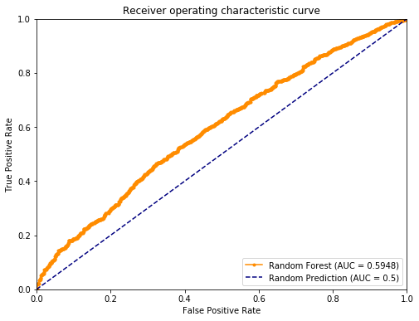
Random forest – code
Lending

